Slide 1

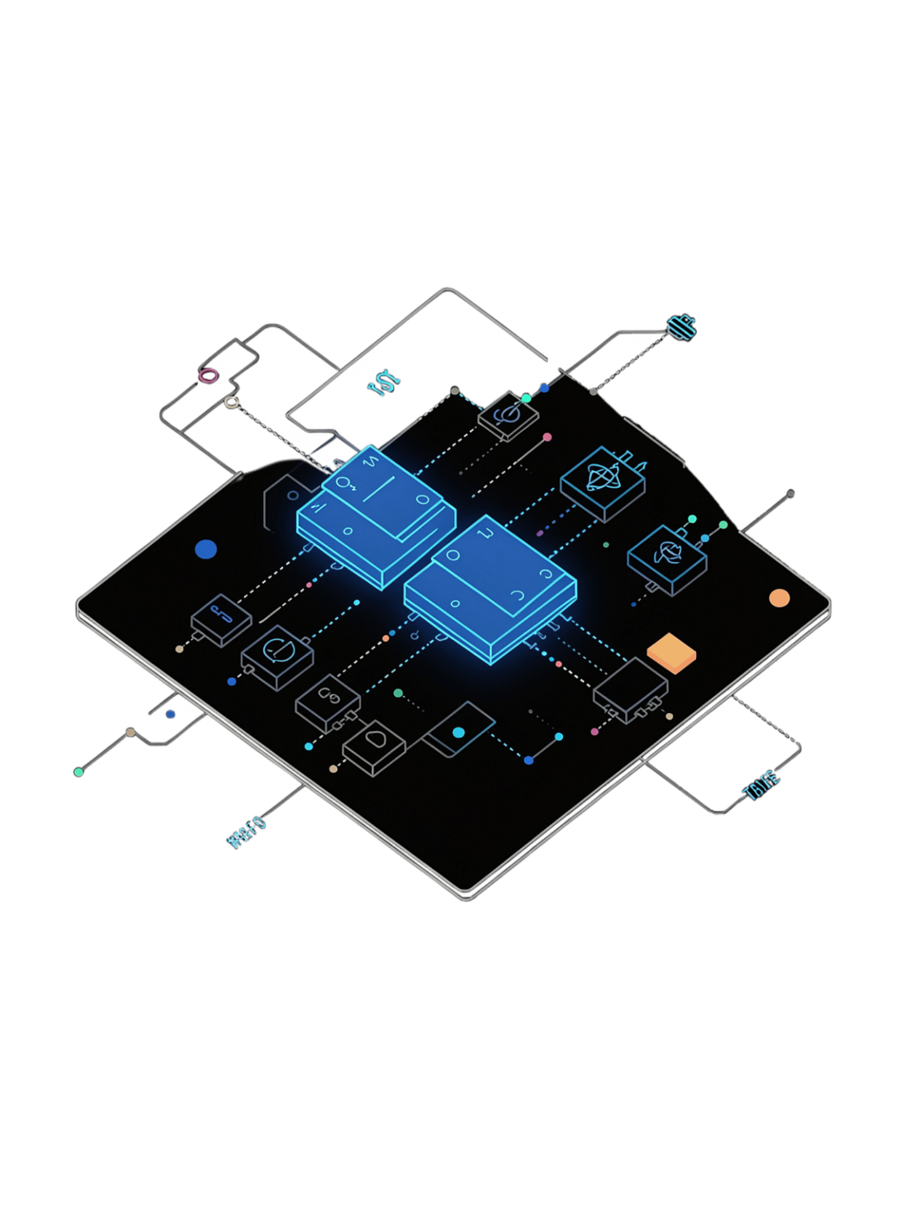
Design and Simulation of Adder and Subtractor Using Logisim
Digital Logic Design – Circuit Construction and Simulation
PROJECT MEMBERS
SAHASRA DHANALAKOTI — 2620030411
RITHVIK REDDY — 2620030483
RITHWIK PATRUDU — 2620030484
SESHAM BAVESH KURN — 2620030486
SRAVANI REDDY — 2620030488

Slide 2
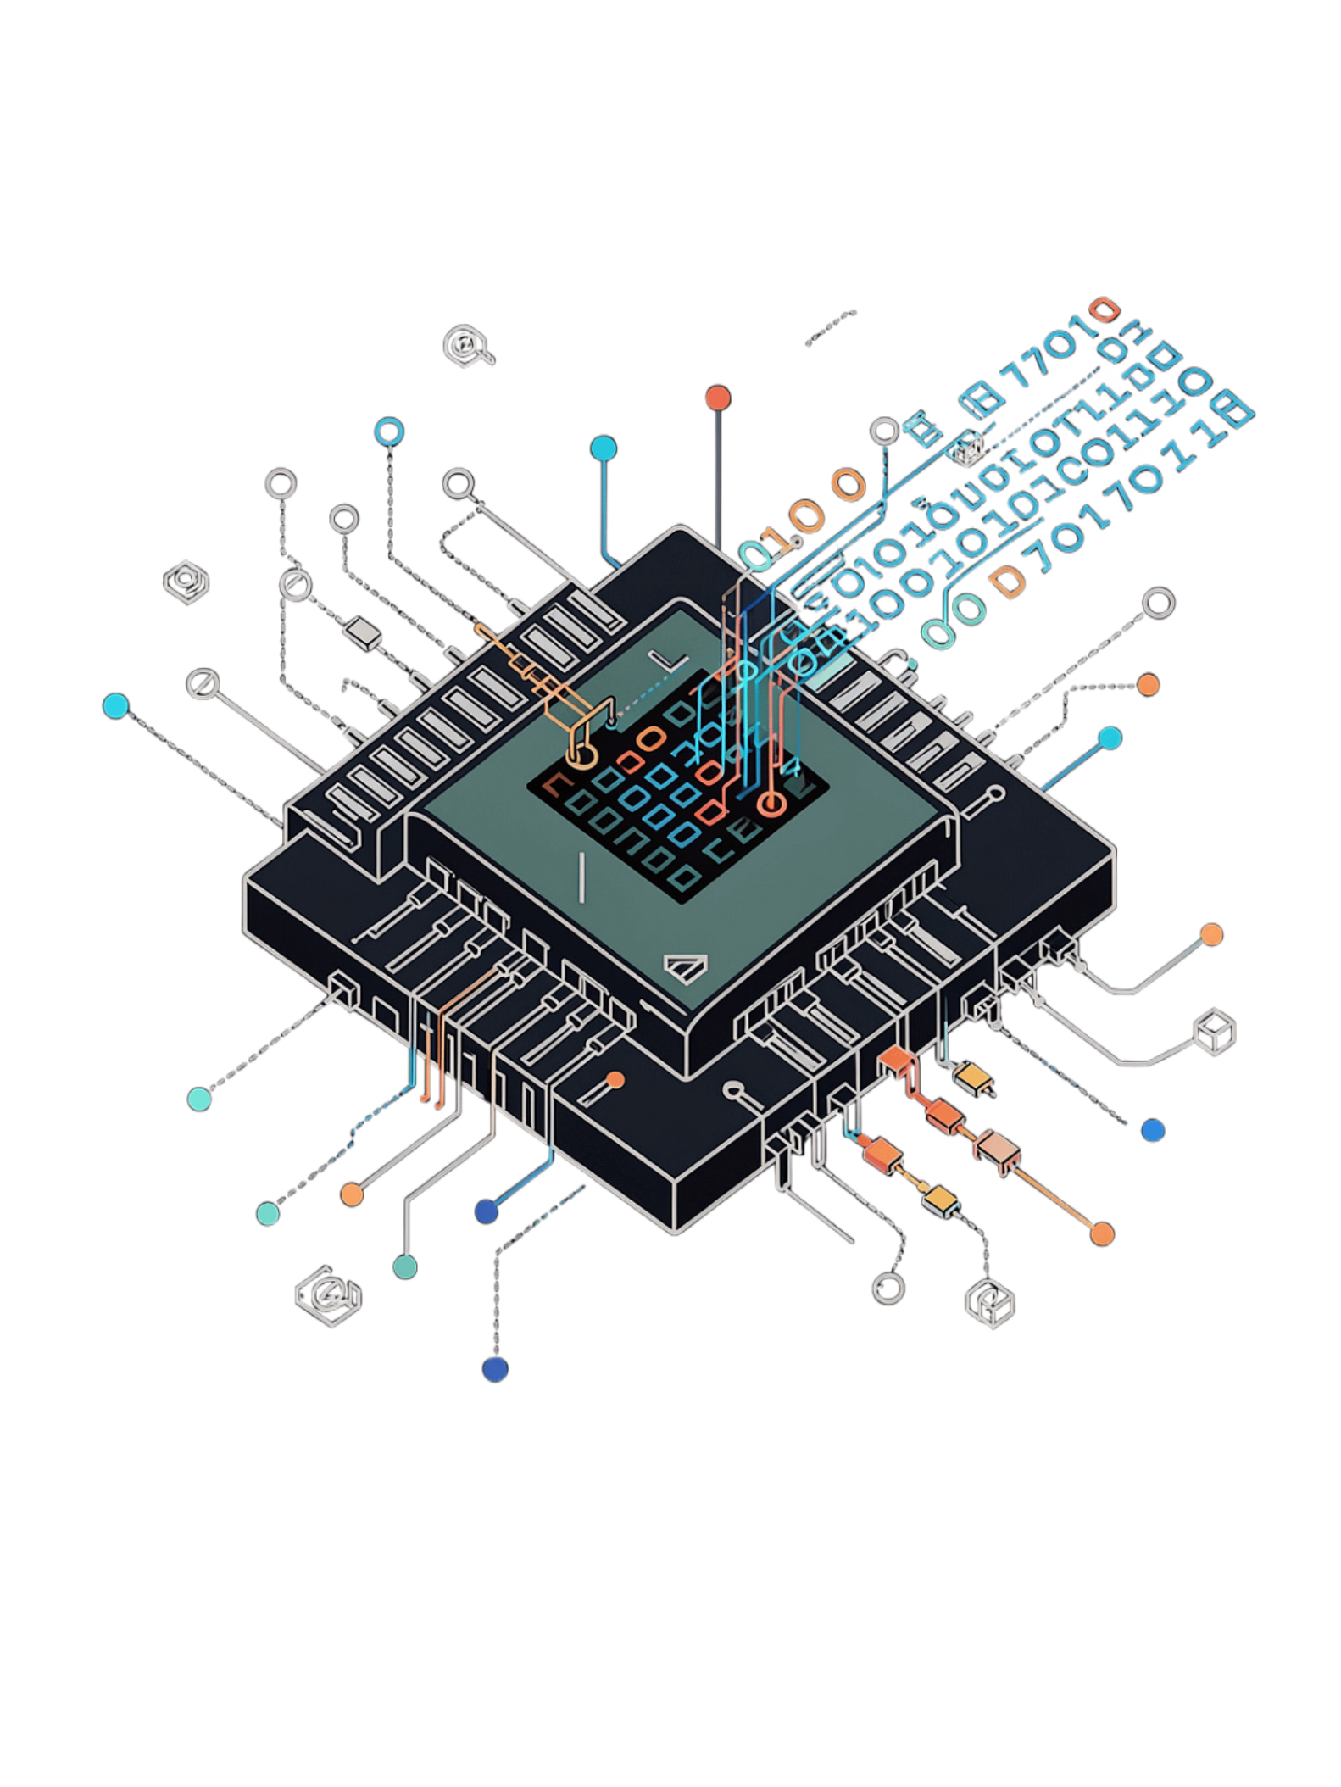
Introduction to Binary Arithmetic
Binary Arithmetic
Foundation of all digital systems and computations
Adders
Combine two binary numbers to produce Sum and Carry outputs
Subtractors
Find the difference between binary numbers using Difference and Borrow outputs
Logisim
Powerful simulation tool for designing, testing, and verifying digital circuits

Slide 3
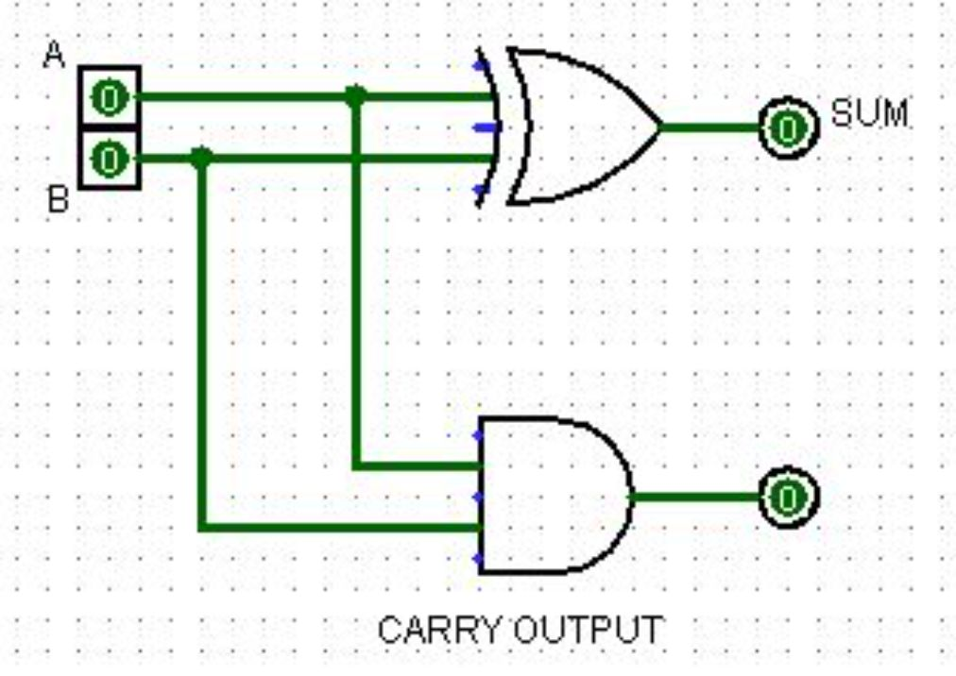
Half Adder Circuit
Logic Gates
XOR gate → produces the Sum output
AND gate → produces the Carry output
Inputs & Outputs
Inputs: A and B (single-bit binary values)
Sum = A ⊕ B
Carry = A · B

Slide 4
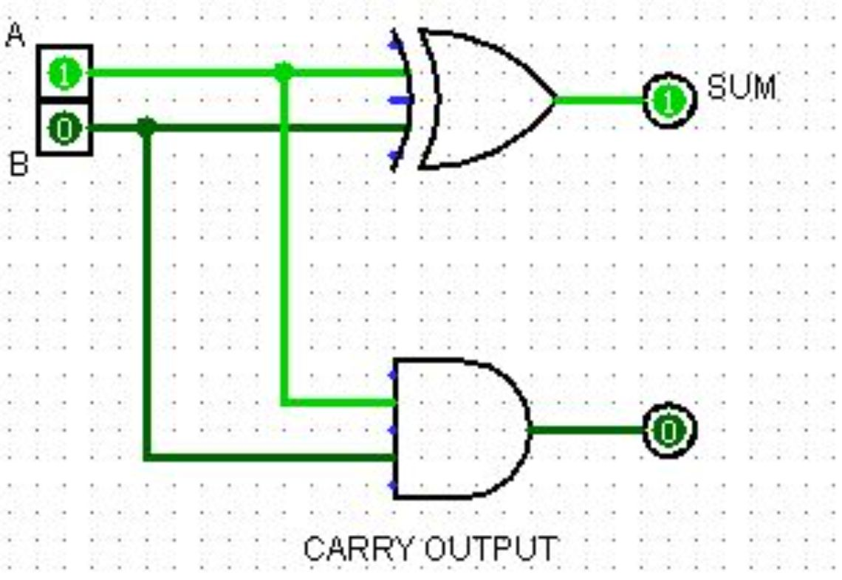
Half Adder Truth Table
Truth Table Results:
A | B | Sum (A ⊕ B) | Carry (A · B)
0 | 0 | 0 | 0
0 | 1 | 1 | 0
1 | 0 | 1 | 0
1 | 1 | 0 | 1
Key insight: Carry output is 1 only when both inputs are 1 — a pure AND operation.

Slide 5
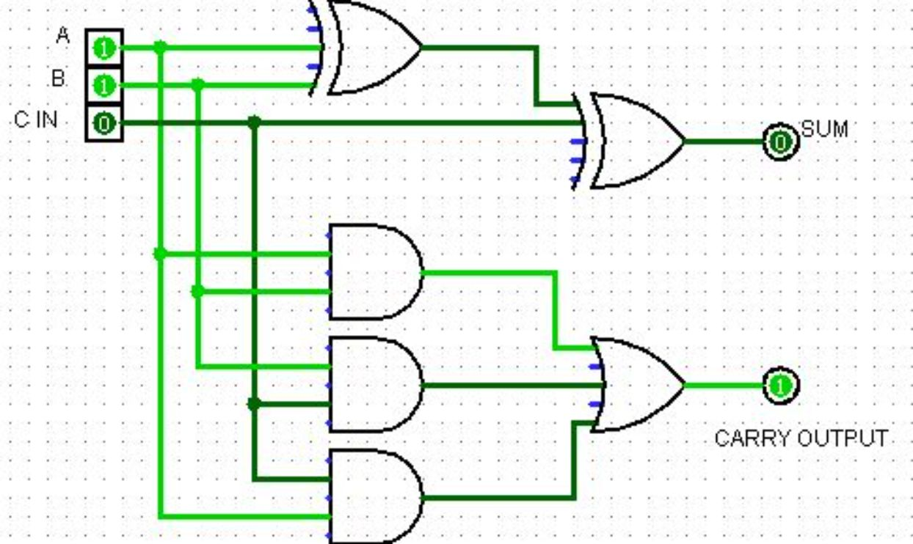

Full Adder Circuit
Components
Two Half Adders cascaded with one OR gate to handle the carry-in signal.
Inputs
A — first binary input
B — second binary input
Cin — carry-in from previous stage
Boolean Expressions
Sum = A ⊕ B ⊕ Cin
Cout = AB + Cin(A ⊕ B)
Enables multi-bit addition through cascading multiple Full Adder stages.

Slide 6
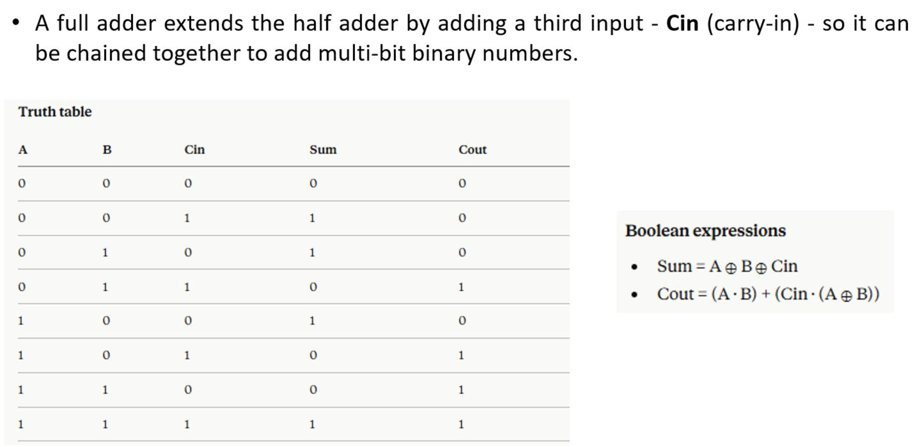
TRUTH TABLE OF FULL ADDER

Slide 7
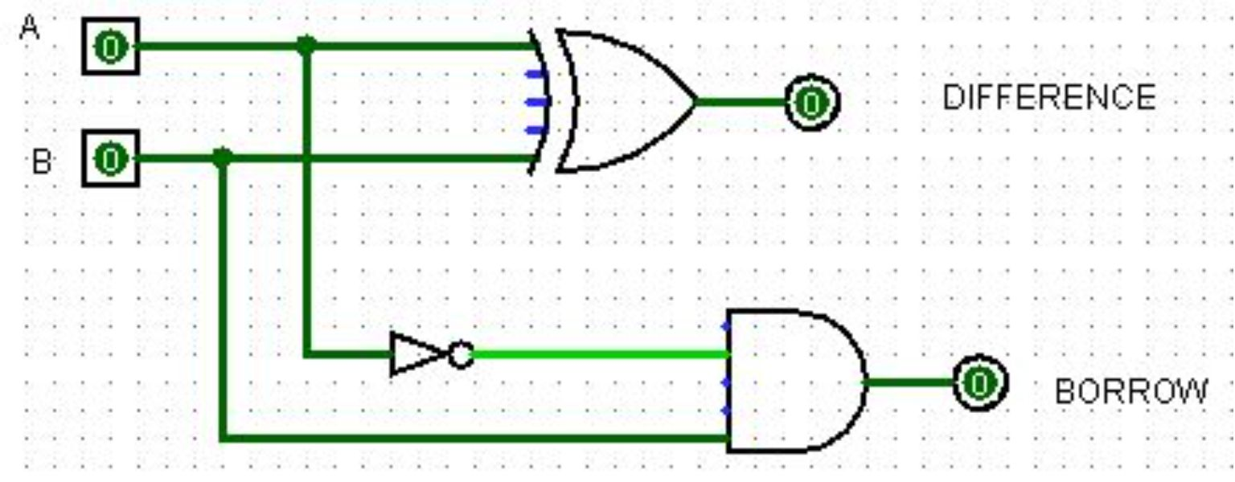
Half Subtractor Circuit
Logic Gates Used
Inputs
XOR gate — computes the Difference output
AND + NOT gate — computes the Borrow output
A — Minuend (the number being subtracted from)
B — Subtrahend (the number being subtracted)
Outputs
Limitation
Difference = A ⊕ B
Borrow = A' · B
Cannot handle borrow-in from a previous subtractor stage — restricted to single-bit subtraction.

Slide 8
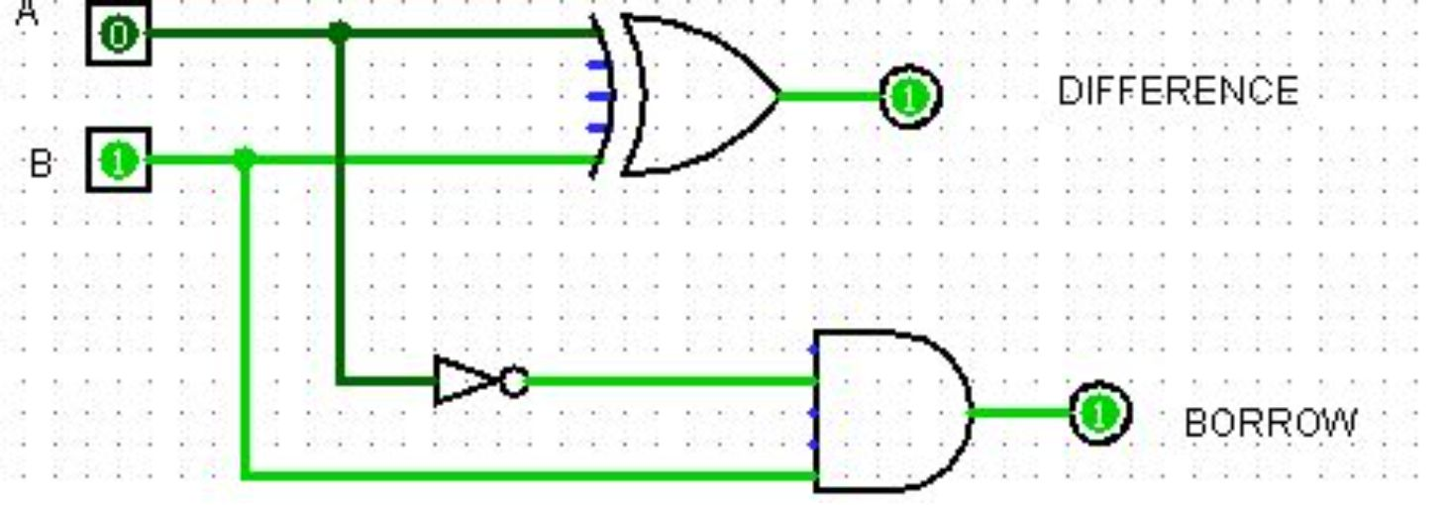
Half Subtractor Truth Table
Truth Table Results:
A | B | Difference (A ⊕ B) | Borrow (A' · B)
0 | 0 | 0 | 0
0 | 1 | 1 | 1
1 | 0 | 1 | 0
1 | 1 | 0 | 0
Key insight: Borrow occurs when subtracting a larger bit (1) from a smaller bit (0) — i.e., 0 − 1 requires borrowing.

Slide 9
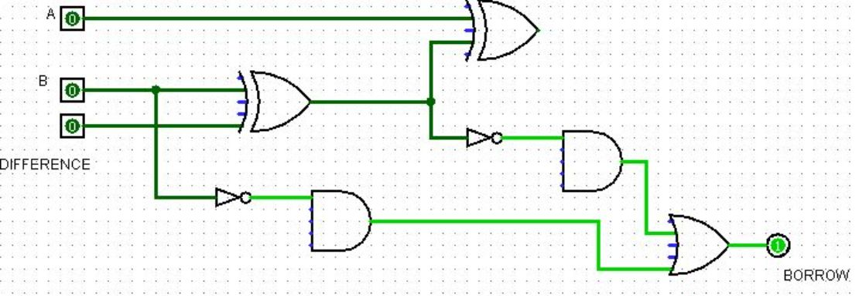

Full Subtractor Circuit
Components
Two Half Subtractors combined with additional logic to handle the borrow-in signal from a prior stage.
Inputs
A — Minuend
B — Subtrahend
Bin — Borrow-in from previous stage
Boolean Expressions
Difference = A ⊕ B ⊕ Bin
Bout = A'B + Bin(A' ⊕ B)
Enables multi-bit subtraction through cascading — the backbone of ALU subtract operations.

Slide 10
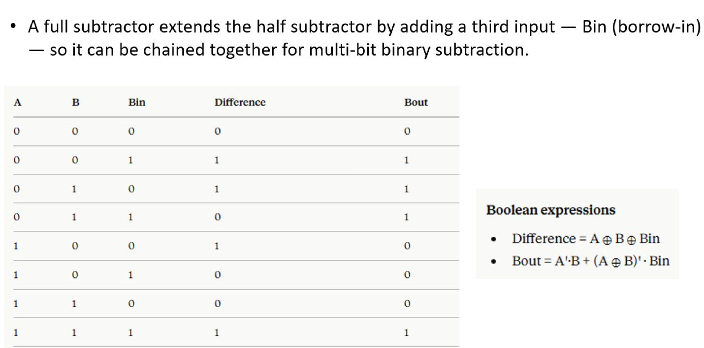
TRUTH TABLE OF FULL SUBTRACTOR

Slide 11
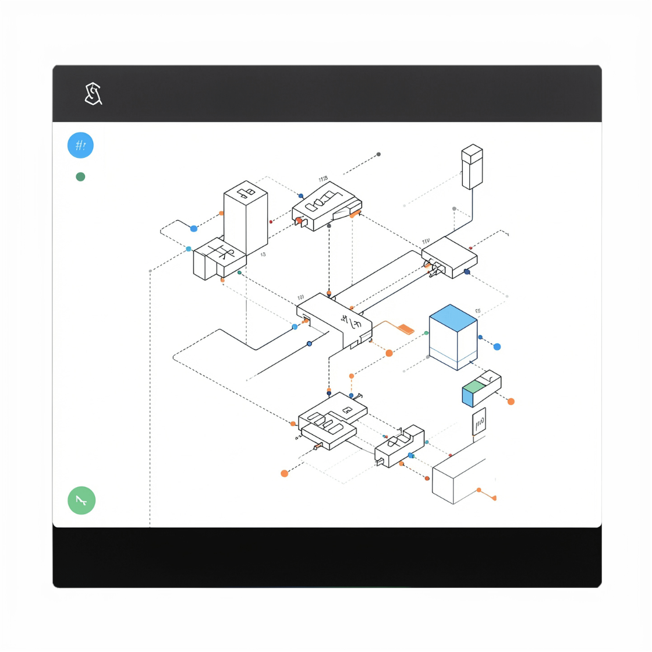
Logisim Simulation & Testing
01
Circuit Construction
Drag-and-drop gates onto the canvas and connect inputs/outputs with wires in Logisim.
02
Input Control
Toggle switches to set values for A, B, and carry/borrow-in signals interactively.
03
Output Monitoring
LED indicators display live Sum/Carry or Difference/Borrow outputs in real time.
04
Verification
Compare all simulation results against expected truth table values to confirm correctness.

Slide 12
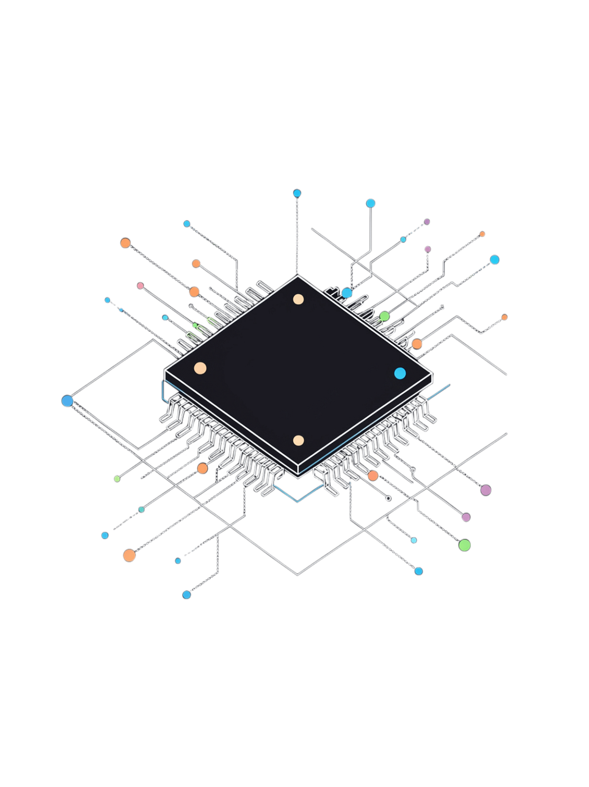
Conclusion & Applications
Adders in Practice
Used in ALUs, calculators, and processors to perform all arithmetic and address computation operations.
Subtractors in Practice
Enable comparison, counting, and signed arithmetic — essential for control flow and data processing.
Cascading Stages
Multiple stages create n-bit adders/subtractors — the building blocks of real-world digital systems.
Next Steps
Explore multipliers, dividers, and advanced arithmetic circuits to extend your digital design skills.

Slide 13


